Slide 1


ALY 6000
E-Commerce Customer Data
Muhammad Umer
Submitted to: Prof John Wilder

Slide 2


Content
About the Dataset
03
Observation 1
04
Observation 2
05
Observation 3
06
Observation 4
07
Observation 5
08
Observation 6
09
References
10

Slide 3
About the Dataset
The "E-commerce Customer Behavior and Purchase Dataset" is a synthetic dataset. It simulates a comprehensive e-commerce environment, capturing various aspects of customer behavior and purchase history within a digital marketplace. This dataset has been designed for data analysis and predictive modeling in the field of e-commerce. It is suitable for tasks such as customer churn prediction, market basket analysis, recommendation systems, and trend analysis.

Slide 4
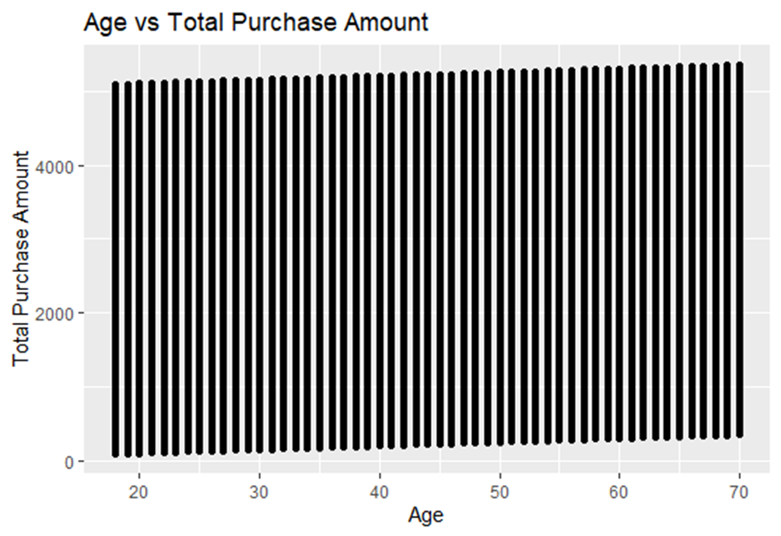

Observation - 1
Observation
Wide range of total purchase amounts across age groups (20-70 years old).
No strong linear relationship between age and purchase amount.
High and low purchase amounts are distributed across all ages.
Slight concentration of higher purchase amounts in the 30-50 age range.
Follow-up
What marketing strategies can be tailored for different age groups based on their preferred product categories?
1. Age vs Total Purchase Amount

Slide 5
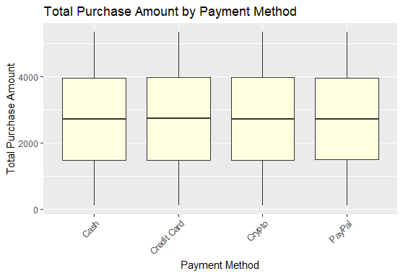
Observation - 2
Observation
Similar median purchase amounts across all payment methods.
Cash and PayPal show wider interquartile ranges, indicating more variability in purchase amounts.
Credit card purchases have a slightly higher median.
Follow-up
Investigate why credit card purchases tend to be higher.
2. Total Purchase Amount by Payment Method

Slide 6
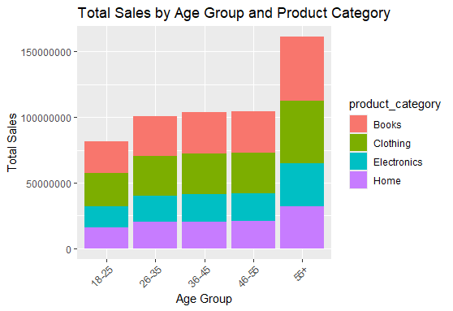
Observation - 3
Observation
Sales increase with age, peaking in the 46-55 and 55+ age groups.
Electronics is the top-selling category across all age groups.
Clothing is the second-highest selling category.
Book sales remain consistent across age groups.
Home goods sales increase with age.
Follow-up
Develop targeted marketing strategies for each age group based on their preferred product categories.
3. Total Sales by Age Group and Product Category

Slide 7
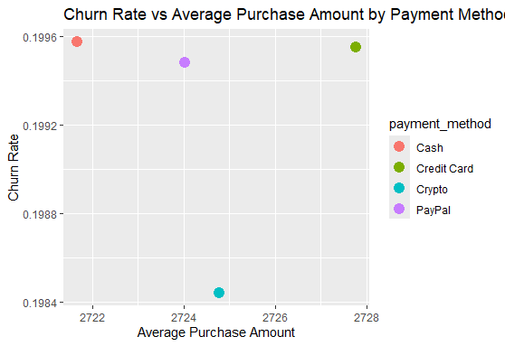
Observation - 4
Observation
Cash users have the highest churn rate despite low average purchase amounts.
Credit card users have a high churn rate but the highest average purchase amount.
Crypto users have the lowest churn rate and a moderate average purchase amount.
Follow-up
Investigate why cash users churn more frequently and implement retention strategies.
4. Churn Rate vs Average Purchase Amount by Payment Method

Slide 8
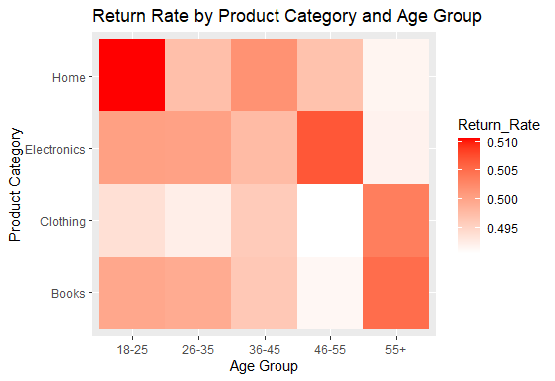
Observation - 5
Observation
Home products have the highest return rates, especially among younger customers.
Electronics show high return rates across all age groups.
Books have relatively low return rates, with a slight increase in the 46-55 age group.
Follow-up
Improve product descriptions and quality for home goods to reduce returns..
5. Return Rate by Product Category and Age Group

Slide 9
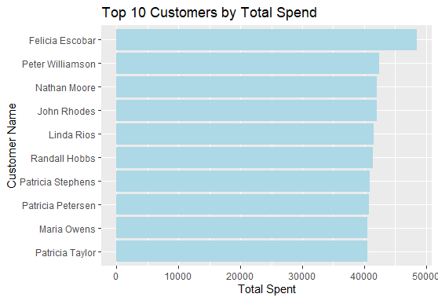
Observation - 6
Observation
Significant gap between top spender (Felicia Escobar) and the rest.
Top 10 customers have similar spending levels with a gradual decrease.
Three customers named Patricia are in the top 10.
Follow-up
Implement a VIP program to retain these high-value customers.
6. Top 10 Customers by Total Spend

Slide 10




REFERENCES
E-commerce Customer Data for Behavior Analysis. (2023, September 15). Kaggle. https://www.kaggle.com/datasets/shriyashjagtap/e-commerce-customer-for-behavior-analysis
https://youtube.com/playlist?list=PLtL57Fdbwb_C6RS0JtBojTNOMVlgpeJkS&si=9XfHphC-3i6dE41X

Slide 11

















Thank You!
Any Questions?

